Slide 1
Anticipating threats in natural Systems
UNCLASSIFIED
Task Title: Integrated Risk-Based Environmental Modeling of Extreme Coastal Weather Events
Environmental Systems Modeling Team:
Dr. Todd Steissberg (ERDC-EL)
Mr. John Kucharski (ERDC-EL)
Dr. Jennifer Olszewski (ERDC-EL)
Ms. Marriah Abellera (USACE-IWR)
Matt Smith (USACE-IWR)
Dr. Billy Johnson (LimnoTech, Inc.)
Ms. Lauren Melendez (ERDC-EL)
External Collaborators:
Scott Steinschneider (Cornell)
Sudarshana Mukhopadhyay (Cornell)
Peter Ruggiero (Oregon State University)
Jon Herman (UC Davis)
ACTIONS IPR Meeting, September 21, 2023

Slide 2
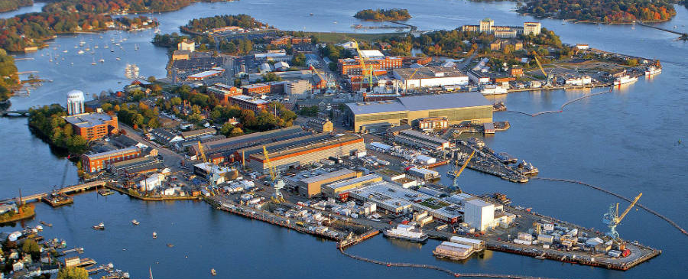
Considerations
Coastal margins are comprised of a complex network of terrains, including intertidal wetlands and mudflats of national significance, which serve as habitat for endangered riparian and aquatic species. These areas, like other coastal zones, are exposed to a web of compound hazards that affect water quality, environmental quality, and maneuverability over the terrain. Challenges include interannual periods of low flow, which impact salinity, soils, vegetation, and water supply, as well as periods of anomalously high water levels. Both high and low water levels are tied to interlinked phenomena that occur on hourly to interannual time scales.

Slide 3
Objective
The objective of this task to develop integrated models that simulate water levels and flow, water quality (salinity, nutrients, temperature, and contaminants), vegetation dynamics (in collaboration with our ACTIONS partners), land use change, and dynamic adaptation pathways. Risk-based time series of extreme coastal events will drive water quality and land use impact models, from which a full understanding of vulnerabilities and dynamic adaptation pathways will be developed. These integrated models will enable military installation planners and managers to assess and respond to risks to natural infrastructure in their coastal settings.

Slide 4
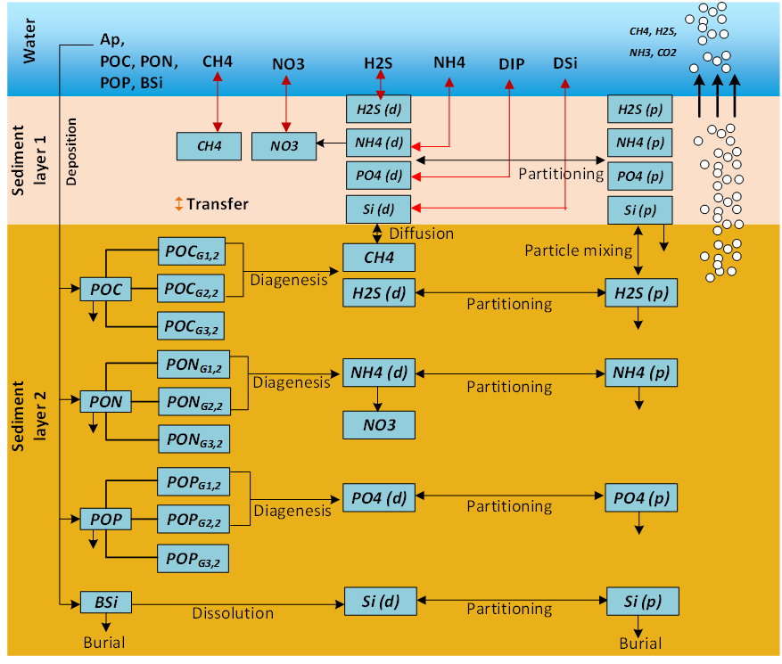
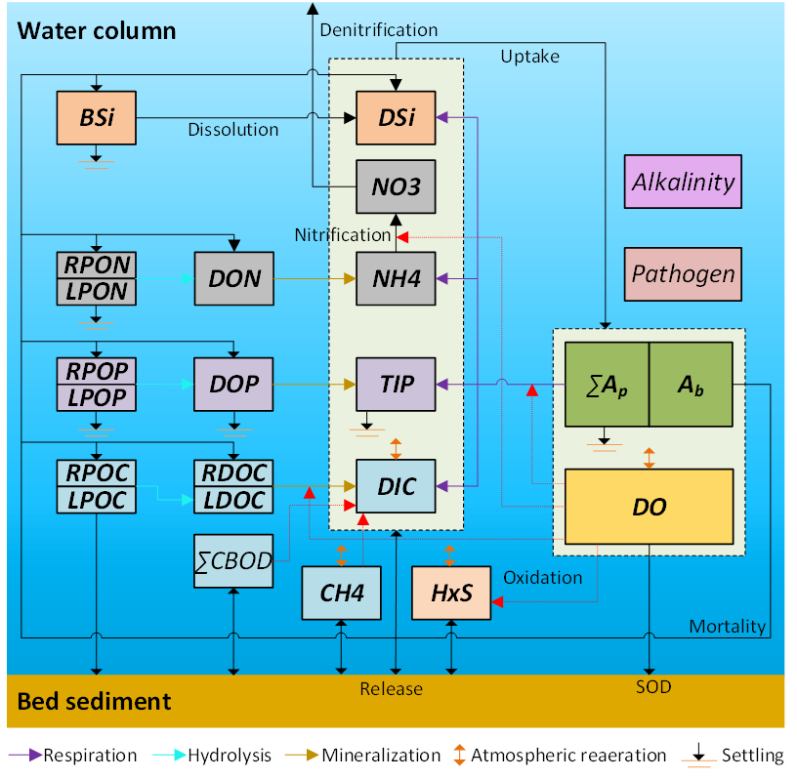
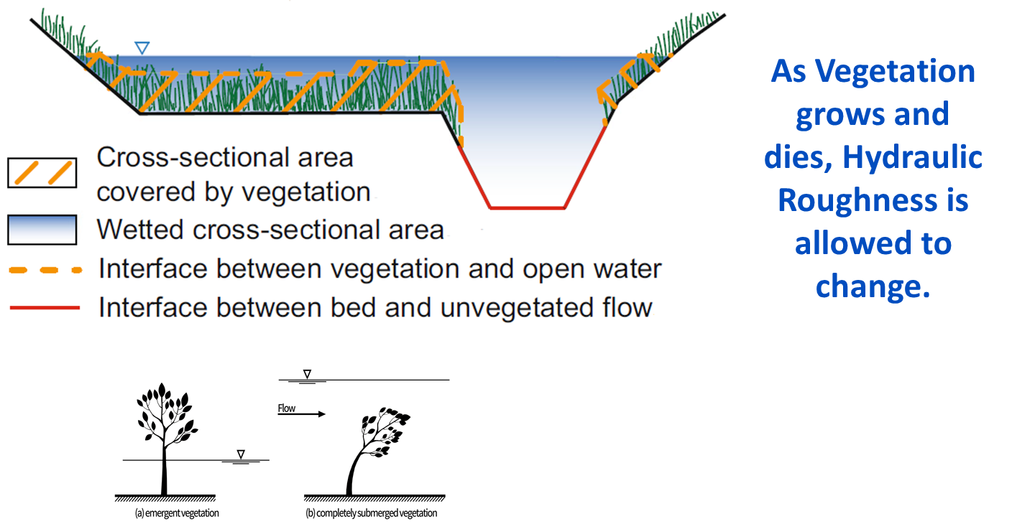
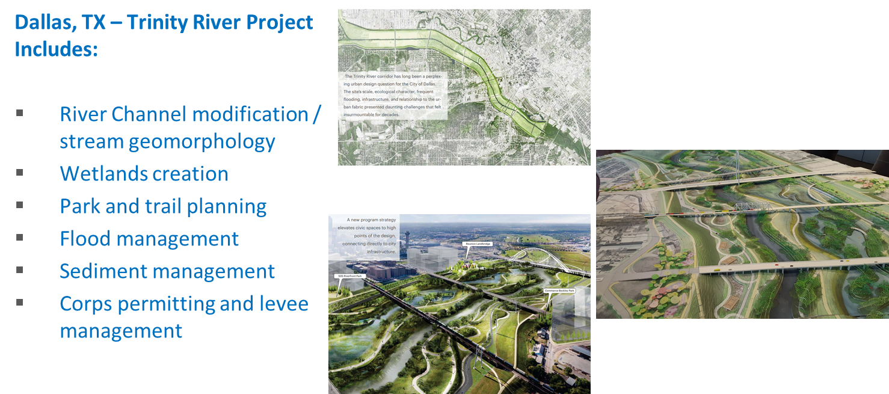
Objective: Integrated Hydro-Ecological Modeling
Develop integrated hydro-ecological models that simulate the complex and dynamics interactions between hydrology, meteorology, climate, water quality (salinity, temperature, nutrients), soil chemistry, vegetation, and morphology processes.
Models will enable evaluating system vulnerabilities and identifying adaptation pathways to improve the resilience of coastal ecosystems to environmental stresses, such as increasing frequency and intensity of coastal storm surges and extreme precipitation events, rising sea levels, decreasing freshwater flows, and increased salinity intrusion.

Slide 5
Objective: Integrated Hydro-Ecological Modeling
Models will incorporate process descriptions from the other ACTIONS teams to provide the ability to simulate future conditions and provide more rigorous design tools for construction of Nature Based Features (NBF).
Provides tools for Engineering with Nature (EWN) projects that accurately simulate future conditions with and without projects at the temporal and spatial scales necessary for engineering design

Slide 6
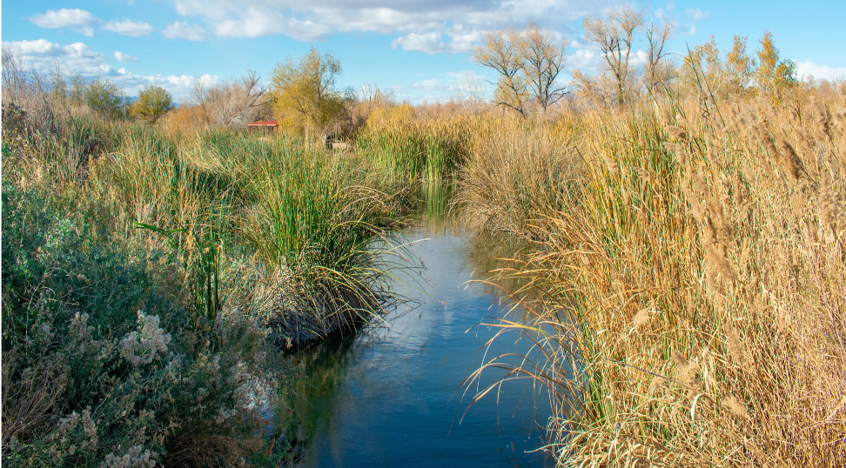
Environmental Modeling Tasks
Environmental Forcing Models
Simulate combinations of environmental forcing conditions to generate a plausible range of coastal hazards while preserving the complex interaction between contributing processes
Water Quality Models
Ecological Models
Relate indicator species responses - e.g., growth and health to water balance components, soil conditions, surface and subsurface water quality - to environmental forcing
Simulate watershed and riverine water quality and contaminant release from soils under saline conditions

Slide 7
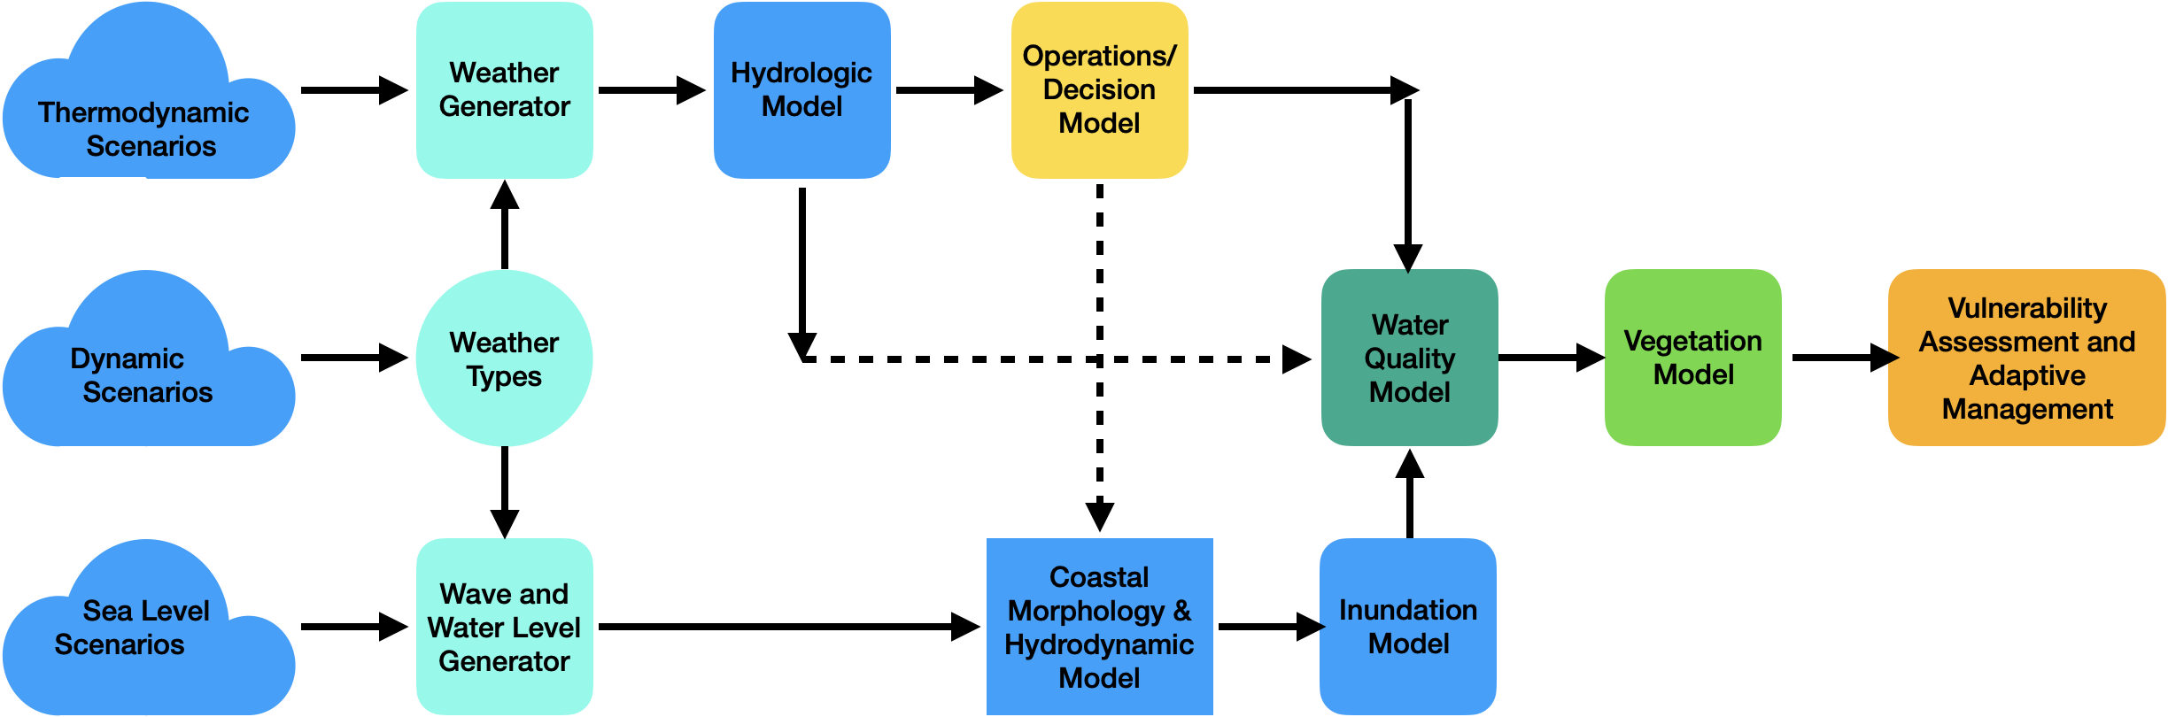
System Modeling Framework

Slide 8
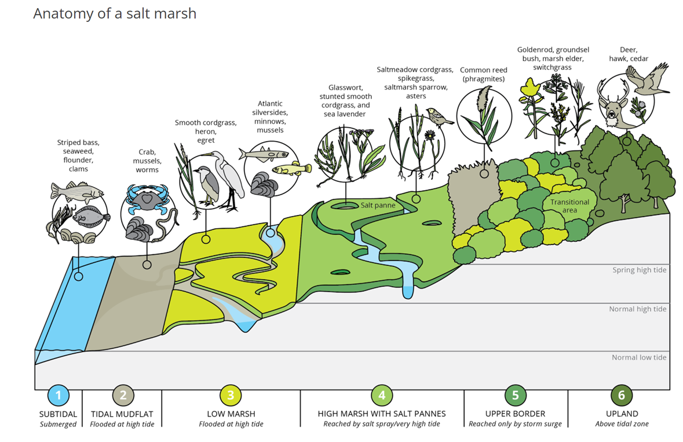
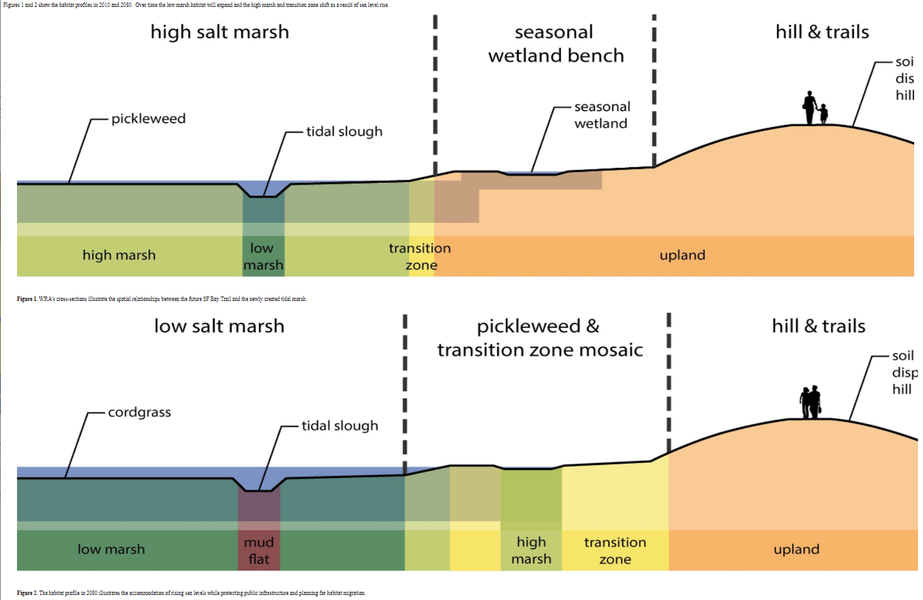
Hydro-Ecological Salt Marsh Model (Task 11)
Objective: Develop a “unit” salt marsh model that can demonstrate how to:
Design salt marshes for specific performance objective(s) that are robust to range of potential future sea level and sediment input conditions
Quantify performance using measurable performance metric(s)
Identify those marsh parameters (e.g., platform depth, vegetation species dominance, etc.) to which performance is most sensitive to.
Lead to the development of generalized salt marsh model design guidelines

Slide 9
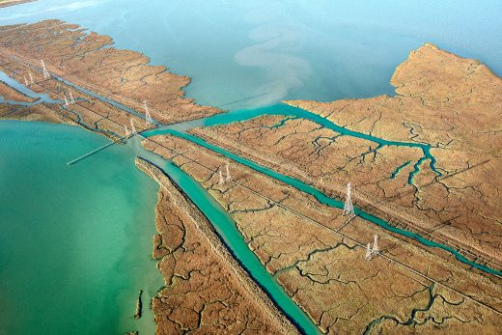
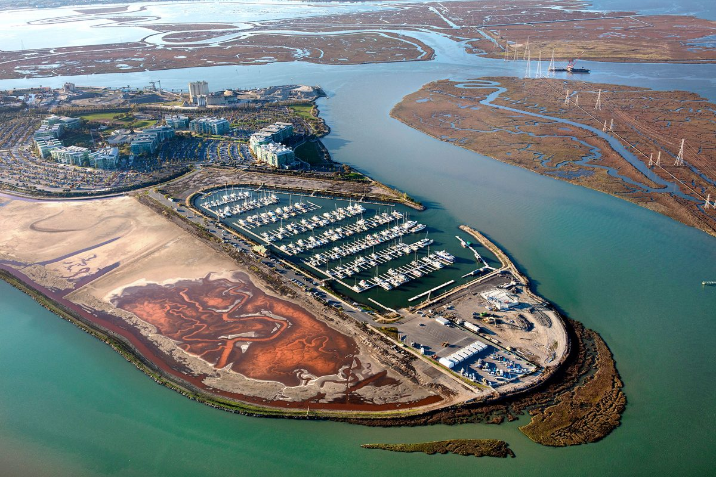
FY23 Model Development
Initiated long-term collaboration with Deltares to explore the modeling of salt marshes with the goal of informing design for specific performance objectives.
Designed the dynamic salt marsh model. The model will dynamically couple hydrodynamics (Delft3D), waves (Waves-D), vegetation (NBSDynamics), and morphology (SEMIDEC) models. This work was performed in collaboration with IWR (Dr. Matt Smith) and Deltares.
Working meeting with Deltares (in Delft) Oct 24-27: Finalizing and linking the components of the salt marsh model (hydrodynamics + waves + sediment, morphology, and vegetation growth / death)
Weekly meetings with Deltares Delft 3D experts to continue to make progress on the model

Slide 10
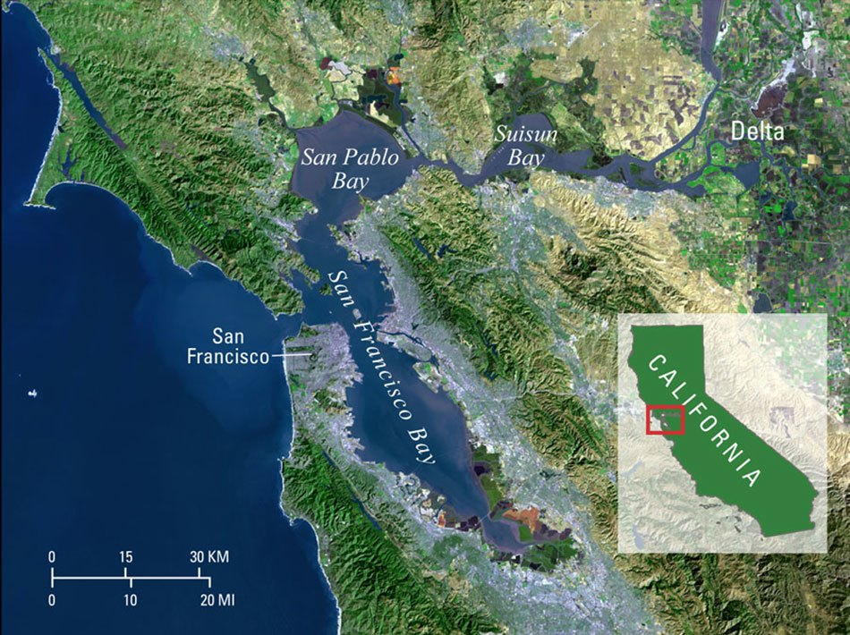
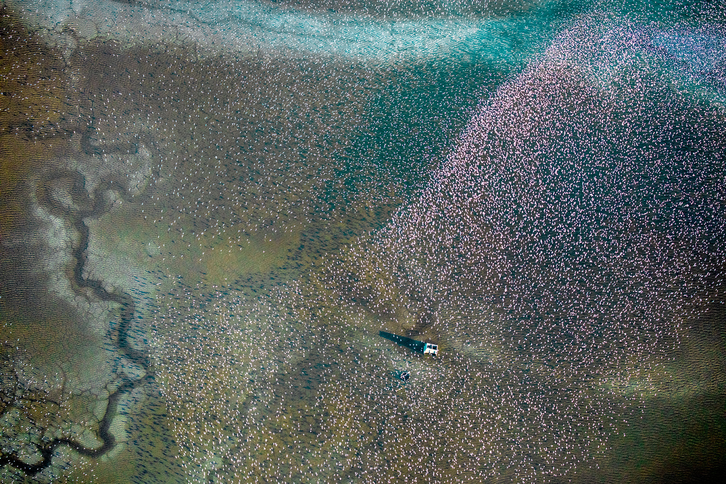
FY23 Model Development
Matt spent 2 weeks and John spent 1 month at Deltares in July to learn about the vegetation life cycle model NBSDynamics and to develop our salt marsh model, which will dynamically couple hydrodynamics (Delft3D), waves (Waves-D), vegetation (NBSDynamics), and morphology (SEMIDEC) models.
Case study under development for an ecosystem restoration site in San Francisco Bay.
John led an EGU session on nature-based features (including salt marshes) and their design
Matt submitted an abstract for our team to present on this salt marsh model at DMDU conference in October in Delft.

Slide 11
FY23 Products: Hydro-Ecological Salt Marsh Model
Developed an open-source python package that couples hydro-morpho-dynamic and vegetation models to compute sedimentation, erosion, and diagenesis of organic matter on salt marshes.
Dynamical version of the SEMIDEC model (Morris and Bowden, 1986)
Model agnostic
Drives Marsh Equilibrium Model (MEM) outputs
This package is being coupled with Delft3D and NBSDynamics

Slide 12
FY23 Products: Journal Publications
Steinschneider, S., Herman, J. D., Kucharski, J., Abellera, M., & Ruggiero, P. (2023). Uncertainty decomposition to understand the influence of water systems model error in climate vulnerability assessments. Water Resources Research, 59, e2022WR032349. https://doi.org/10.1029/2022WR032349
Mukhopadhyay, S., Leung, M., Cagigal, L., Kucharski, J., Ruggiero, P., & Steinschneider, S. (2023). Understanding the natural variability of still water levels in the San Francisco Bay over the past 500 yr: Implications for future coastal flood risk. Journal of Geophysical Research: Oceans, 128, e2022JC019012. https://doi.org/10.1029/2022JC019012

Slide 13
FY23 Products: Conference Presentations
Todd E. Steissberg, Billy E. Johnson, and Zhonglong Zhang, 2023. Eco-Hydrology Engineering Design Tool - ClearWater Capabilities - General Constituents, Nutrients, and Contaminants. European Geophysical Union General Assembly 2023. Vienna, Austria
John Kucharski, Scott Steinschneider, Jennifer Olszewski, Jonathan Herman, Saiful Rahat, Patrick Ray, Wyatt Arnold, and Romain Maendly, 2023. Linking Exploratory Scenarios to Process-Informed Insights in Climate Vulnerability Assessments. European Geophysical Union General Assembly 2023. Vienna, Austria
Jennifer Olszewski, John Kucharski, Matthew Smith, Marriah Abellera, and Todd Steissberg, 2023. Nature-Based Features: Developing a Framework to Shift Them from Risky Investments to Reliable and Robust Solutions. European Geophysical Union General Assembly 2023. Vienna, Austria
Estifanos Addisu Yimer, Billy Johnson, Jiri Nossent, Todd E. Steissberg, Hans Van de Vyver, and Ann van Griensven, 2023. Session: Nature-Based Solutions to Protect Against Hydro-Meteorological Extremes. European Geophysical Union General Assembly 2023. Vienna, Austria.
Matthew Smith, Jennifer Olszewski, John Kucharski, Marriah Abellera, and Todd Steissberg, 2023 (submitted). Evaluating hydrodynamic and biophysical feedbacks leading to steady state conditions in a coastal salt marsh of San Francisco Bay, CA. 10th Annual Conference of the Society for Decision Making Under Deep Uncertainty (DMDU), Delft, the Netherlands.

Slide 14
Projected FY24 Products
Final version of dynamic salt marsh model, Oct 31, 2023.
Technical note summarizing salt marsh model development and case study, Nov 30, 2023.
Peer-reviewed paper on the salt marsh model: “Modeling evolution and dynamic equilibrium of constructed salt marshes using a coupled morphodynamic and vegetation model to evaluate wave attenuation performance”, Sep 30, 2024
Future work (ESTCP): Explore how sensitive performance metrics like wave attenuation are to different design parameters like starting bottom elevation and berm presence/absence.

Slide 15
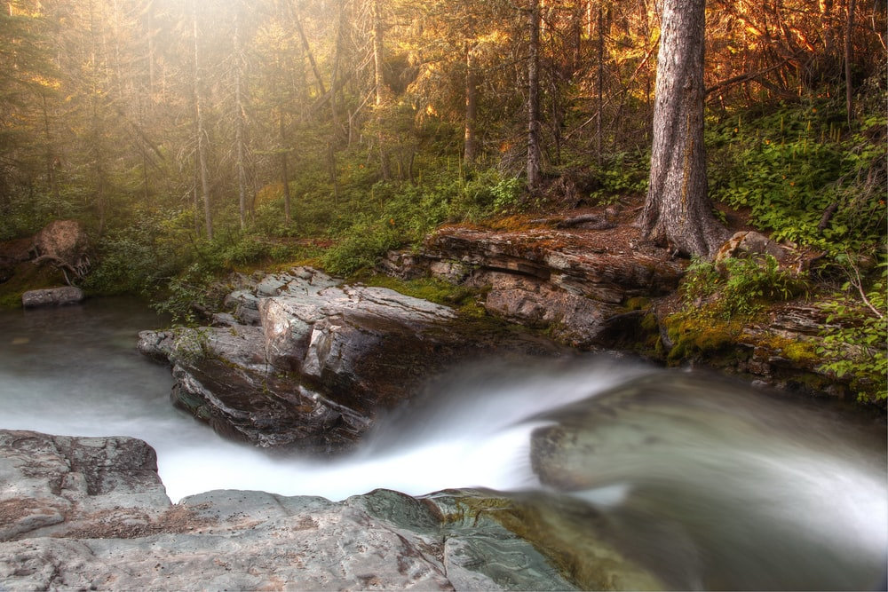
Questions?

Slide 16
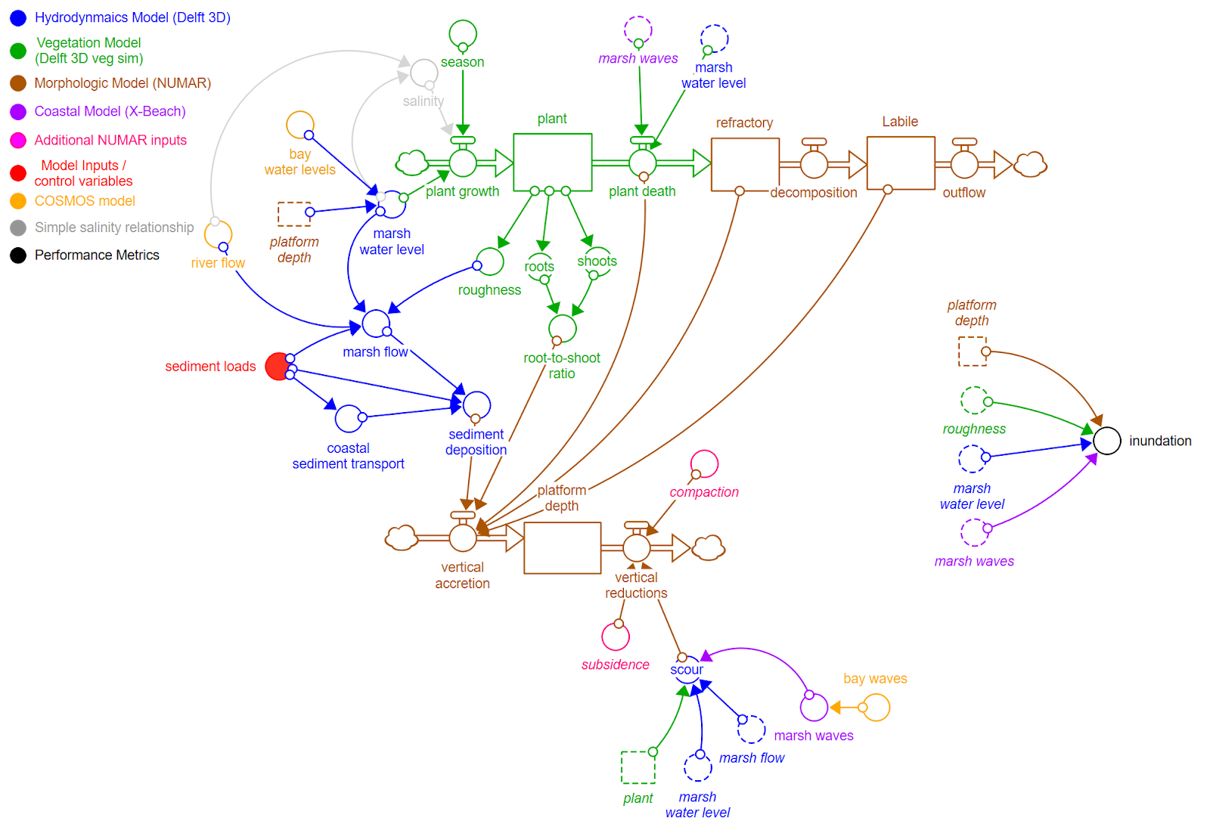
FY23 Accomplishments Hydro-Ecological Salt Marsh Model Design

